Slide 1

Quality beyond accreditation
Quality beyond accreditation
DR.PANKAJ BHOSALE - GANGA HOSPITAL COIMBATORE

Slide 2
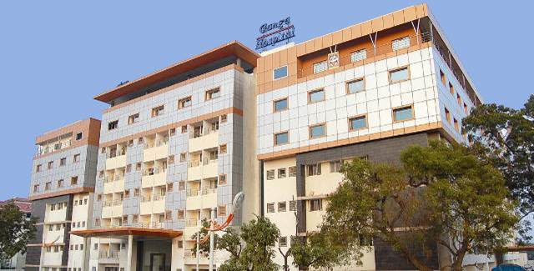
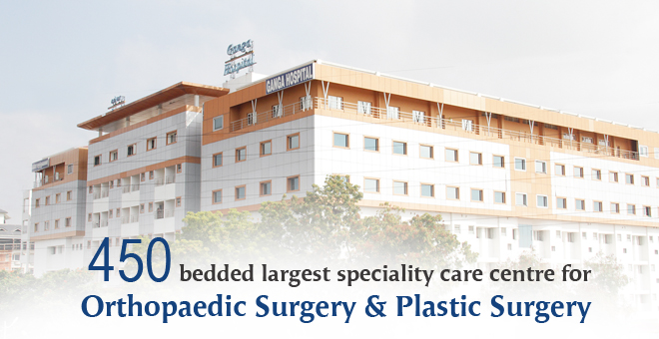
Making a difference in patient care through a 5D concept
450 bedded tertiary speciality referral centre for trauma ,orthopaedic and plastic surgery
Notes:
Ganga Medical Centre has been a tertiary referral institute ,for the last 20 years with state of the art services being provided in the field of orthopaedic trauma,spine trauma,plastic & microvascular reconstructive surgery and anaesthesia. The thrust has been on introducing advanced and latest techniques in various fields of accidental surgery and anesthesia.

Slide 3
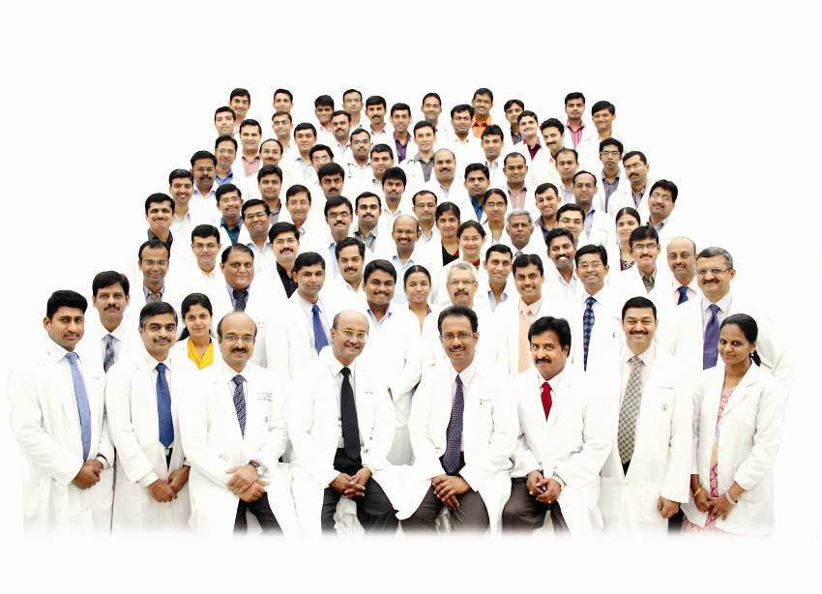
Notes:
The strongest feature of the hospital has been the proper blend of clinical and academic activities and the steady and planned increase of the team members so that the services provided are encompassing all and uptodate.

Slide 4
Achieving a better outcome in patient care through a five dimensional approach
Patient
Surgery
Physiotherapy & nursing
Admin
Anaesthesia
Dietary
Notes:
In my presentation ,I have captured a “5D” i.e a five dimensional approach to achieve a better outcome in patient care through a multidisciplinary approach comprising SURGERY ,ANAESTHESIA,PHYSIOTHERAPY AND NURSING, DIETARY , AND ADMINISTRATION

Slide 5

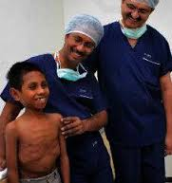
“PATIENT FIRST”

Slide 6
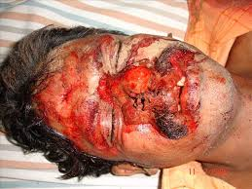
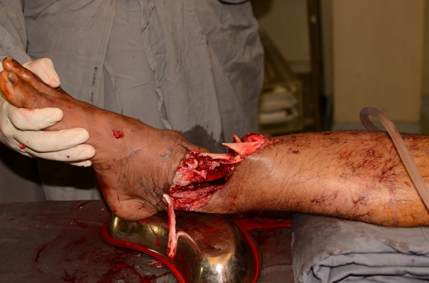
TRAUMA CARE
PRIMARILY FAMILIAR FOR ITS UNMATCHED SERVICE
“ NO TIME IS LOST”
TEMPORARY ID CREATED
POLICE INTIMATION SENT
RESUSCITATION STARTED IMMEDIATELY
INVESTIGATION REPORTS IN 20 MIN
Irrespective ‘ ATTENDERS BEING PRESENT’
Notes:
TRAUMA CARE:Ganga Medical Centre is primarily familiar and widely popular for its excellent and unmatched service in trauma care .It starts as soon as the polytrauma patient arrives to the casualty, “No time is lost” in neither writing the case sheet nor the documentation or any administration formalities,a TEMPORARY ID CREATED IN THE SYSTEM,a police intimation sent,RESUSCITATION STARTED IMMEDIATELY,BLOOD SAMPLES COLLECTED IMMEDIATELY UNDER ALL ASEPTIC PRECAUTIONS WITH BASIC INVESTIGATION RESULTS OBTAINED IN A MAXIMUM TIME PERIOD OF 20 MIN, all this IRRESPECTIVE OF THE ATTENDERS BEING PRESENT.

Slide 7
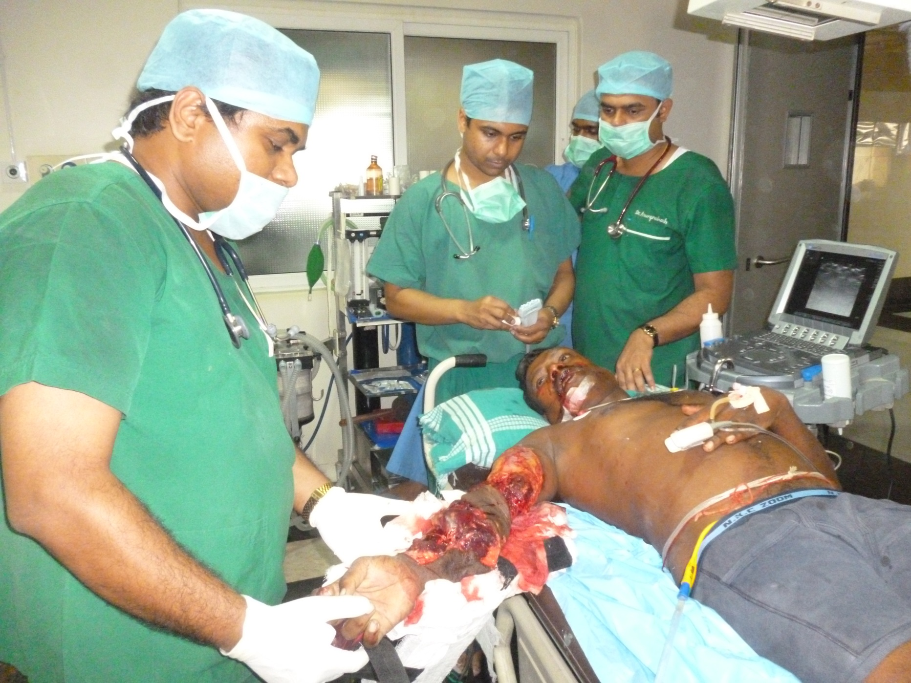
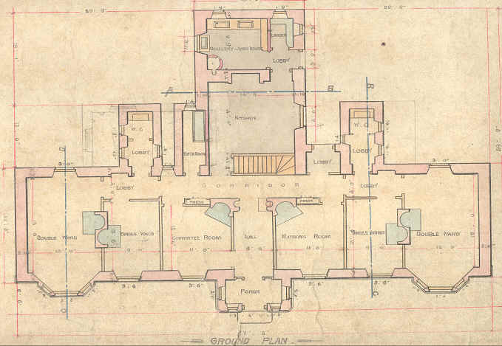

Notes:
When it comes to a patient who is critically injured,THE EDIFICE IS DESIGNED IN SUCH A WAY SO AS TO BE CONDUCIVE ,BENEFICIAL AND CONVENIENT FOR THE severely injured.They are directly shifted to the resuscitation room which is the ANTE ROOM of the operation theatre,where the trauma life support ( airway,breathing ,circulation) is done

Slide 8
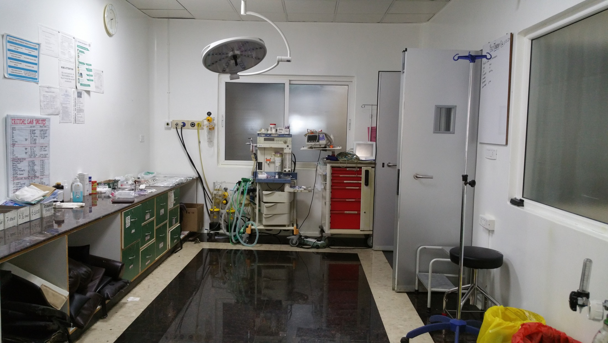
Resuscitation room – ANTE ROOM OF OPERATION THEATRE

Slide 9
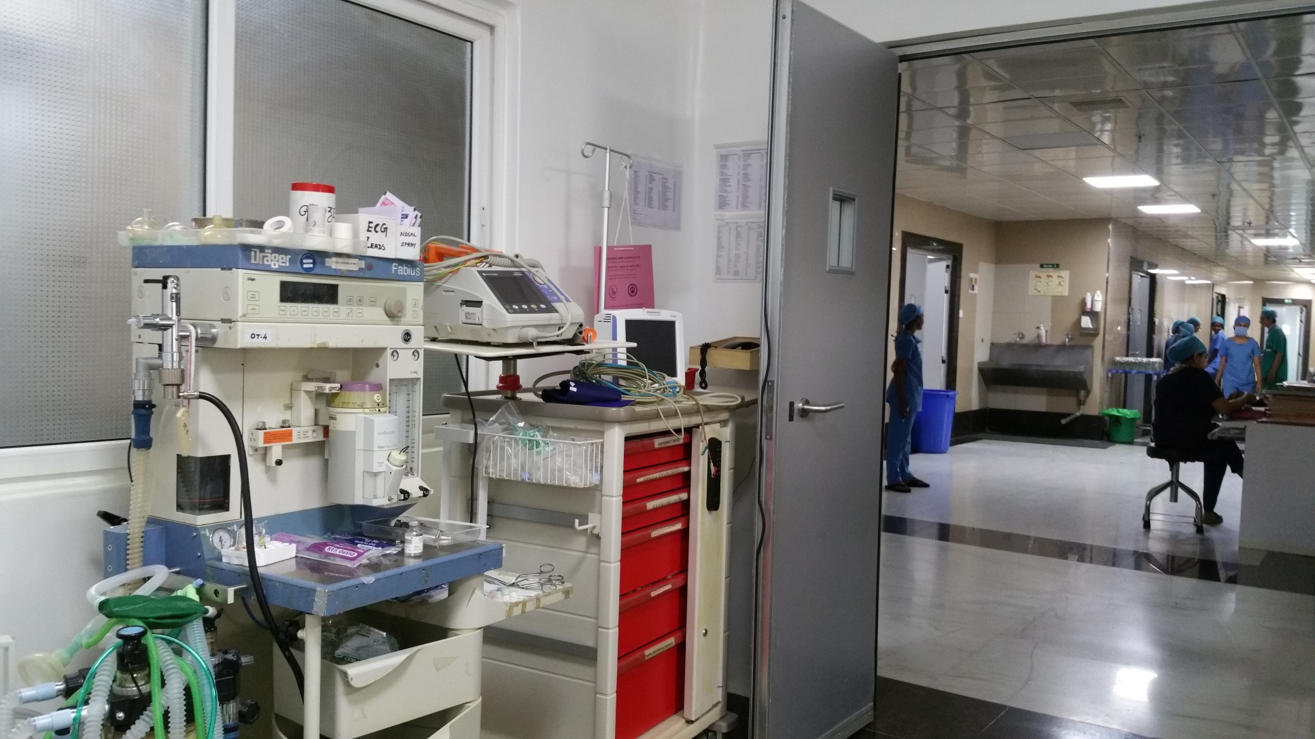

Slide 10
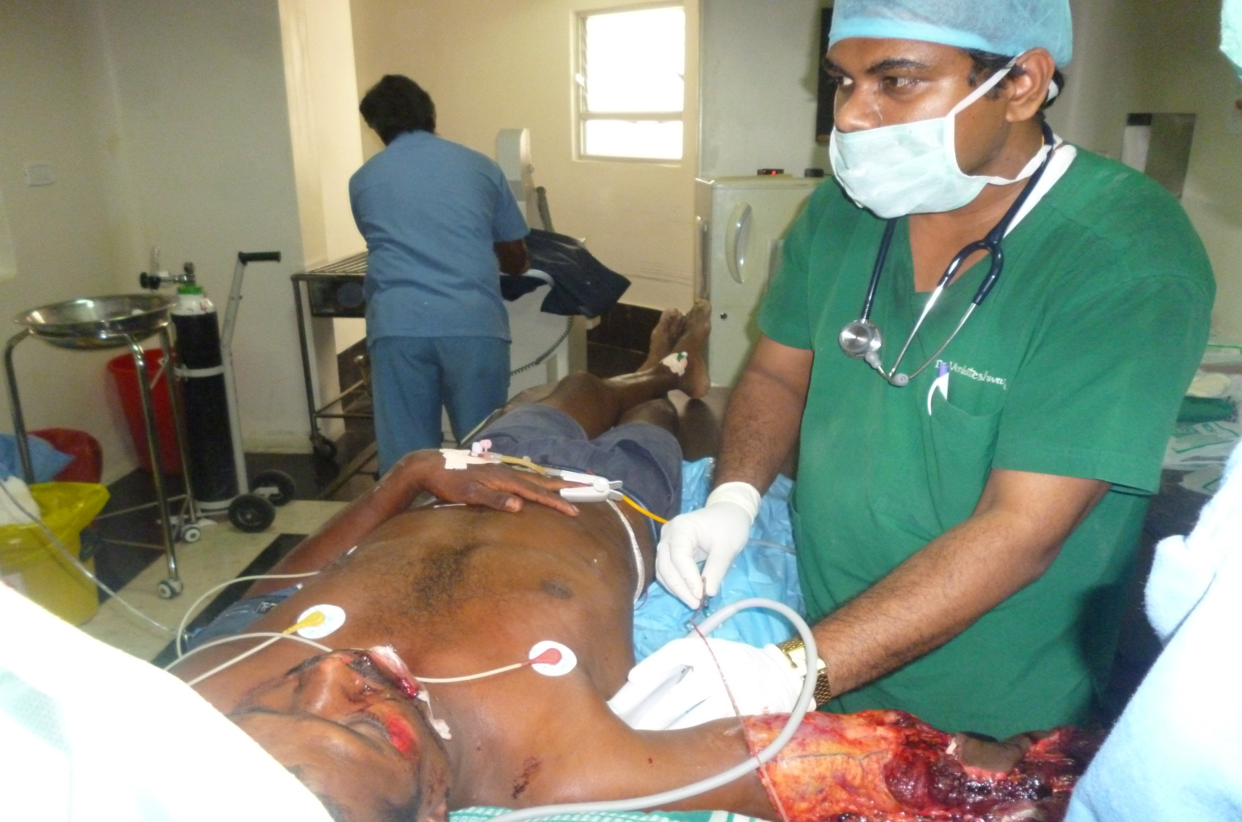
ON ARRIVAL BLOCK
As a part of resuscitation
Notes:
Here the ANAESTHESIOLOGISTS PLAY A PIVOTAL ROLE WITH THEIR “ ON ARRIVAL BLOCK” which has been one of the strongest feature and a game changing intervention in the management of trauma.

Slide 11
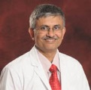
DR.RAVINDRA BHAT

Slide 12
ADVANTAGES OF “ON ARRIVAL BLOCK”
TREMENDOUS DECREASE IN PAIN & STRESS
PATIENTS BECOME CALM
HISTORY TAKING BECOMES EASY
MANIPULATIONS FOR INVESTIGATIONS
IN DIABETIC FOOT OR DEBRIDEMENT PATIENTS
TOURNIQUET TO CONTROL BLEEDING
NOT ONLY AS A RESUSCITATIVE MEASURE
CONSENT FOR LIMB SALVAGING
Notes:
Done majorly for all limb reconstruction or amputation procedures ,giving an “on arrival block” helps in many ways for a positive outcome.It not only reduces the immense pain associated with the trauma ,but also the stress levels,the biochemical and metabolic changes with it.patients become calm and more easy to converse or to obtain history from

Slide 13
PRECAUTIONS FOLLOWED
IN BRACHIAL PLEXUS INJURY
IN OPPOSITE SIDE CHEST INJURY PATIENTS

Slide 14
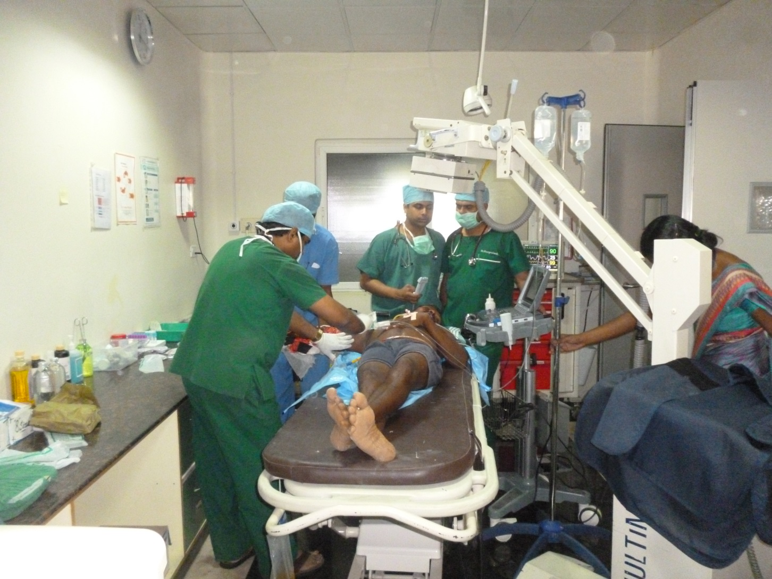
ALL NECESSARY INVESTIGATIONS AT ONE PLACE
Notes:
Once the patient is stabilised ,all investigations such as xrays ,ultrasound are done there itself rather than shifting the patient to any other places for it,as it is highly unadvisable to do so with a hemodynamically unstable patient

Slide 15
GOALS OF RESUSCITATION
SERIAL LACTATE MEASUREMENTS
BIOCHEMICAL MARKERS
Interleukin 6
Notes:
Resuscitation being a gold standard for these patients,it is closely followed by SERIAL LACTATE MEASUREMENTS, AND the seriousness of injury being monitored by INTERLEUKIN 6 ,so use of such high end markers to guide in the management gets you one step ahead.So ,intervening in a right way in the initial few golden hours helps us reduce the percentage of morbidity & mortality associated with polytrauma

Slide 16
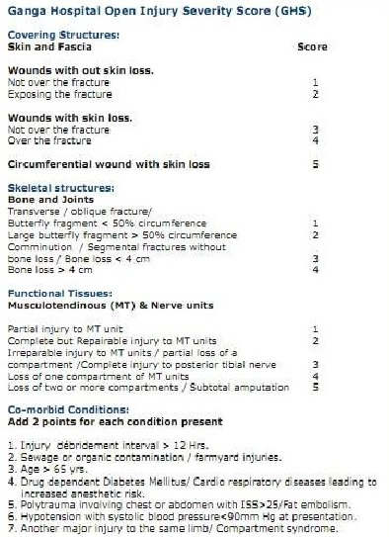
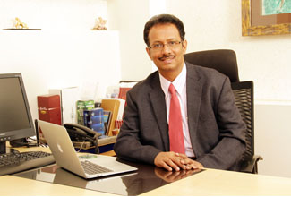
CONTRIBUTION TO WORLD LITERATURE
Notes:
Our contribution to world literature has been the “ ganga hospital open injury severity score” devised by dr.sr et al which has made its place in the standard textbook as an aid to measure the severity of the injury and device a strategy accordingly.

Slide 17
Resuscitative or corrective surgery if required is immediately done with an informed decision taken with the patient and attenders.

Slide 18
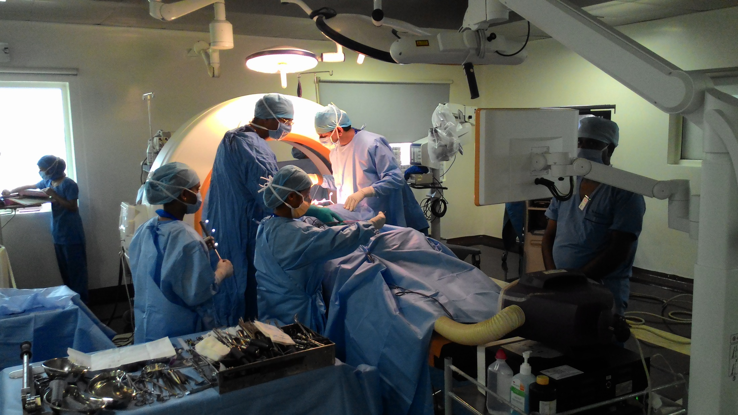
SURGICAL ARMAMENTARIUM
1D: SURGERY

Slide 19
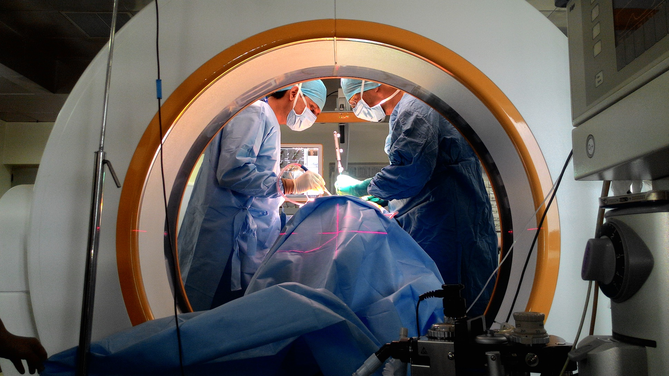
INTRAOPERATIVE CT SCAN

Slide 20
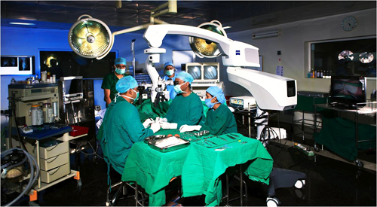
Operating microscopes

Slide 21
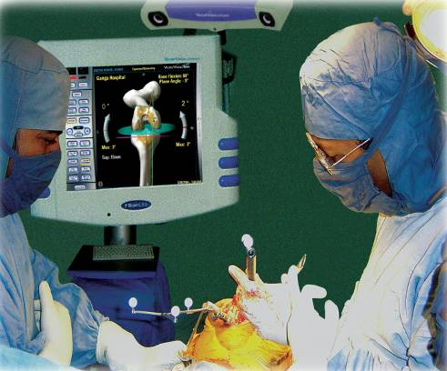
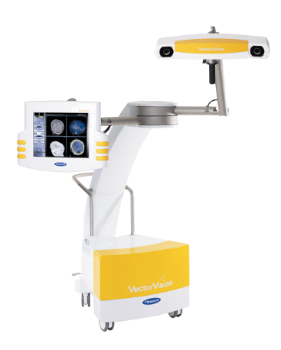
VISUAL 3D IMAGING SURGERY

Slide 22
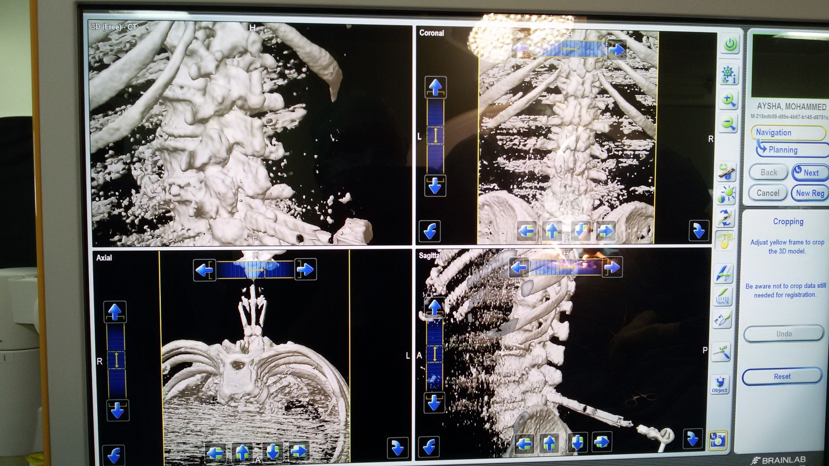
Newer Gadgets….

Slide 23
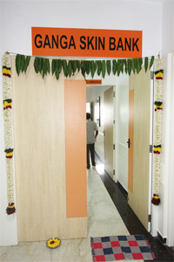
Ganga skin bank
Notes:
There is a huge demand for bone graft at our hospital due to the enormous number of polytrauma and tumor patients who need complex reconstructive procedures.
The bank is currently using well processed and gamma irradiated cortico cancellous bone allografts from tibial slices and femoral heads, bones from amputated stumps in various clinical conditions like comminuted fractures and Non-unions with bone loss of both upper & lower limbs, revision joint replacement surgeries, tumour and spinal fusion surgeries. The grafts are screened for HIV, HCV, HBV and syphilis to eliminate risk of disease transmission.

Slide 24
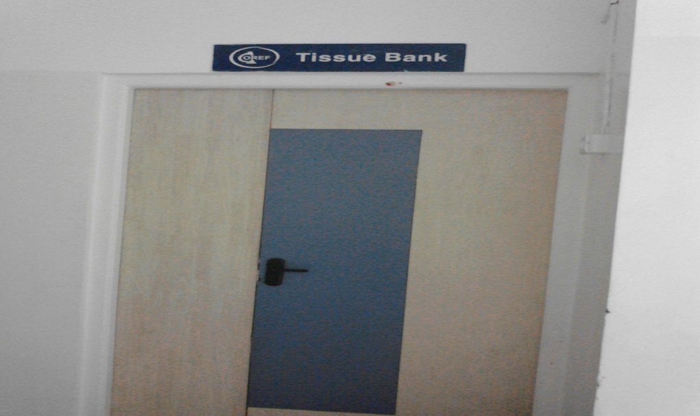
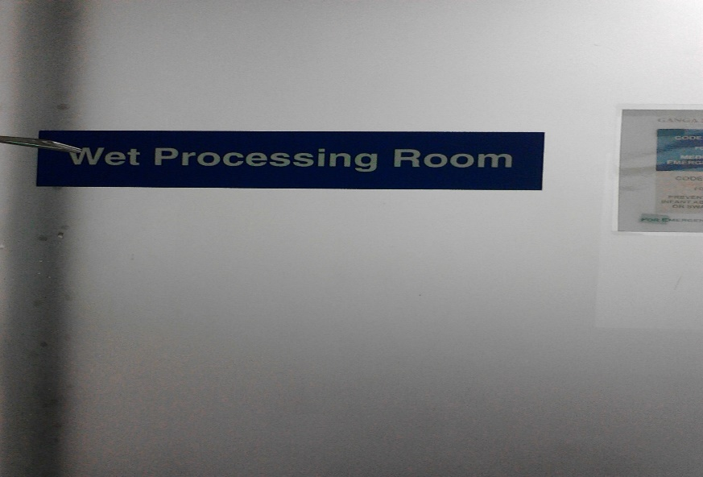
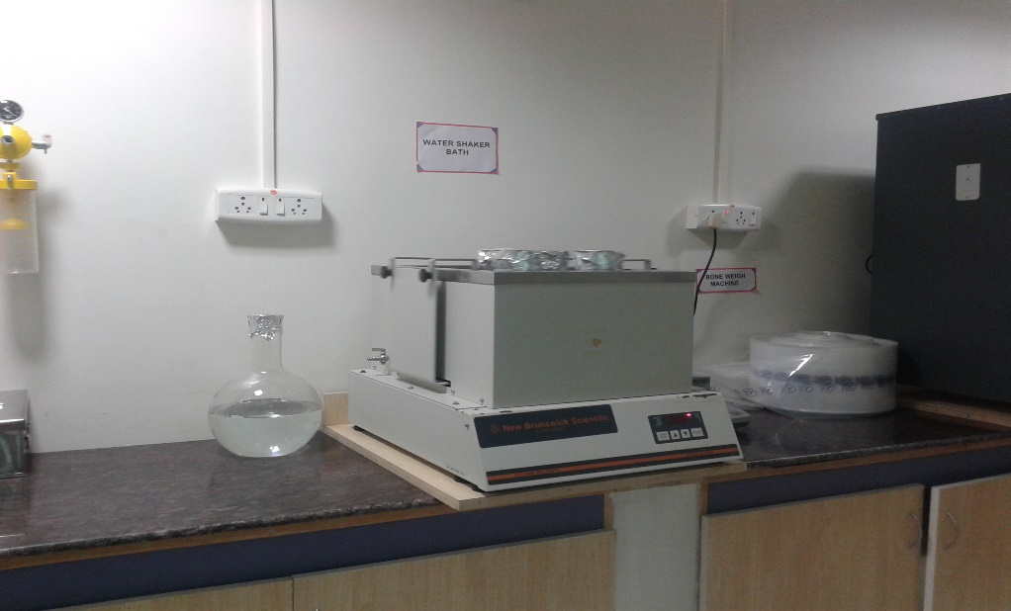
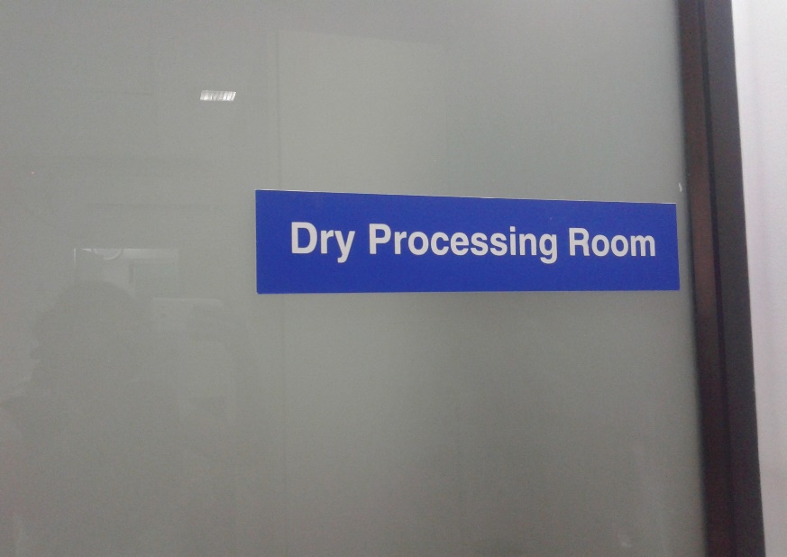
BONE TISSUE BANK

Slide 25
2 D :ANAESTHESIA
PRE- ANAESTHETIC ASSESSMENT/ OPTIMISATION
INTRA-OPERATIVE PROTOCOLS
POST-OPERATIVE CONCERNS
Notes:
The Dept.of anaesthesiology has been providing highest quality of care in all the 3 phases ,preop ,periop and postoperative.as I reiterate the dept also emphasises on the use of all the latest advances in technology to provide the best of quality anaesthesia care

Slide 26
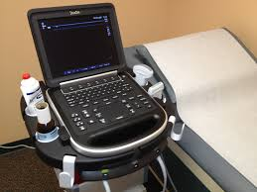
Use of modern gadgets
Notes:
it is equipped with 9 ultrasound machines for providing regional anaesthesia and trauma diagnostic purposes
The hdu and icu are equipped with their own ultrasound machines for regional anesthesia and other diagnostic purposes.

Slide 27
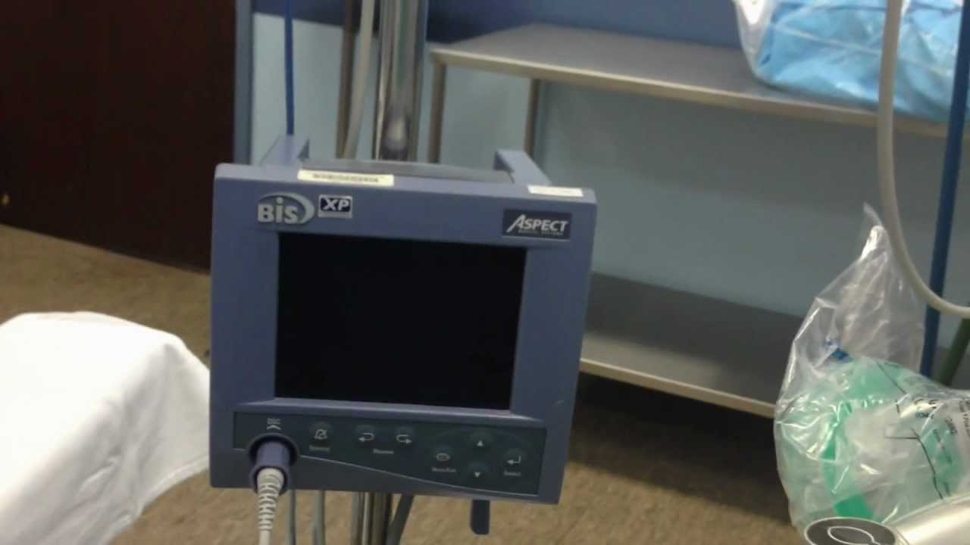
Bispectral index

Slide 28
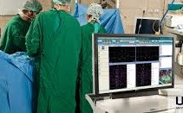
Motor evoked potentials & somatosensory evoked potentials

Slide 29
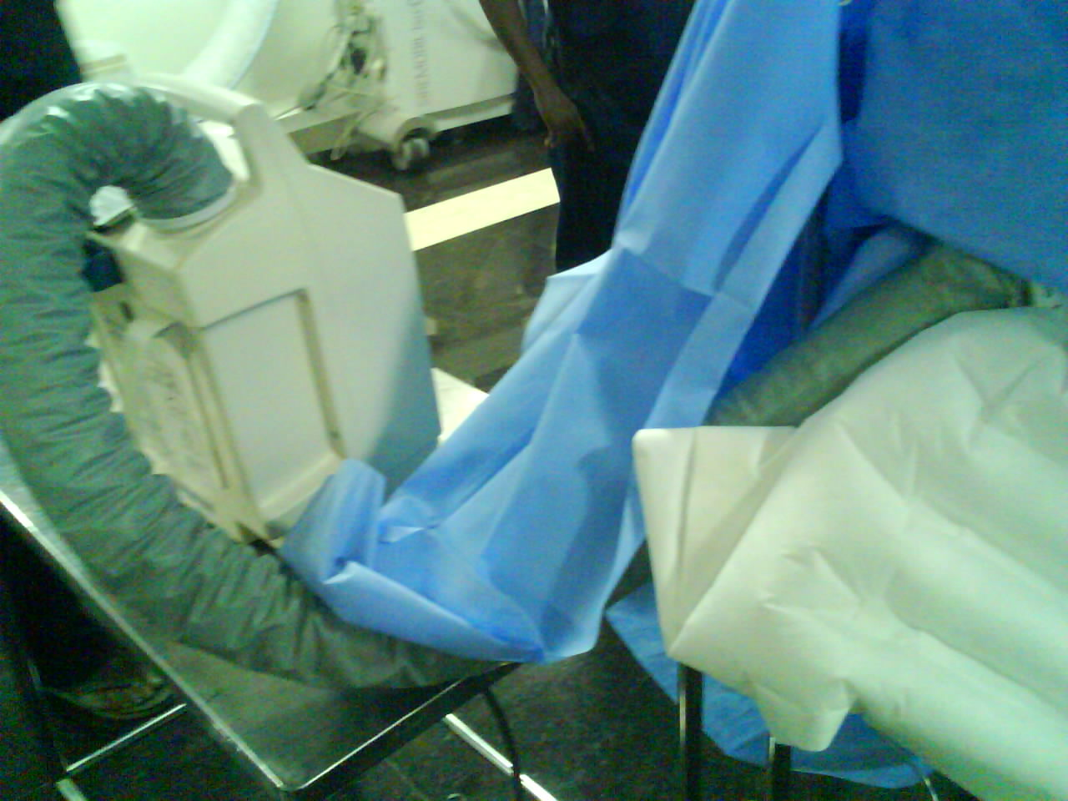
BEAR HUGGERS,THERMAL DRAPES

Slide 30
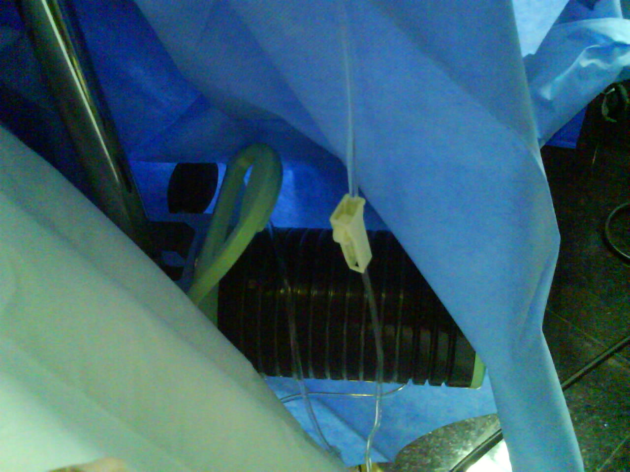
FLUID WARMERS

Slide 31
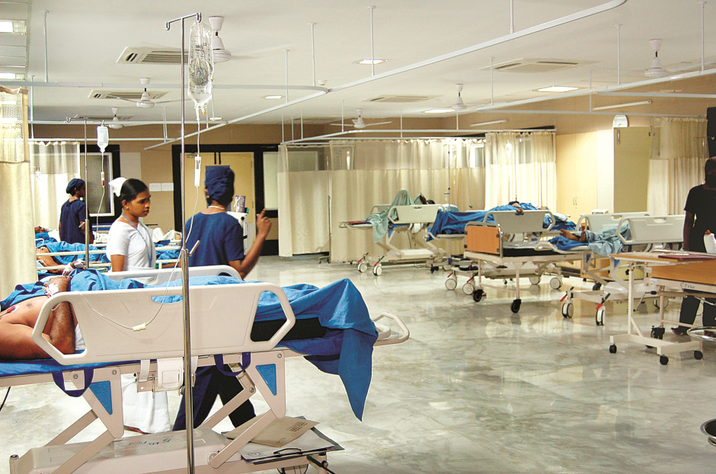
POST OP SERVICES
Zero hour
Criticality
Seventh sense – PAIN
Visual analogue scale < 3
Acute pain service
Ward anaesthetist
Notes:
POSTOPERATIVE services: they start at the zero hour itself as soon as the surgery is over.depending on the surgery or the criticality of the patient ,they are accordingly sent to the postop care unit.electively ventilated patients sent to the icu ,critically ill being sent to the high dependency unit constantly monitored again by the anaesthesiologists and the other set of patients being sent to post op wards.The seventh sense is now regarded as “ PAIN”and we have made it our objective to have a “ VISUAL ANALOGUE SCALE OF LESS THAN 3”.We run an acute pain service system incorporating lot of regional techniques,perineural infusions,intravenous infusions.The HDU AND ICU ARE EQUIPPED WITH THEIR OWN ULTRASOUND MACHINES FOR THE PURPOSE OF REGIONAL ANAESTHESIA. Constant anaesthesia support in the wards is present by a designated “ WARD ANAESTHETIST “ along with a “PHYSICIAN ASSISTANT” affiliated to the dept of anaesthesia.The dept of anaesthesia truly epitomizes what we call “ ANAESTHESIOLOGIST AS PERIOPERATIVE PHYSICIANS

Slide 32
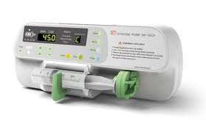
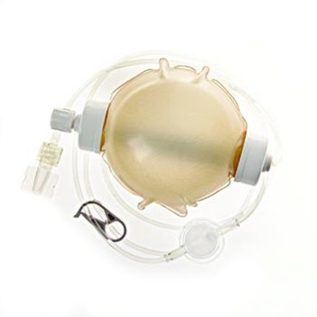
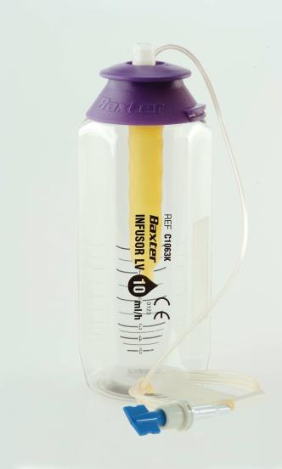
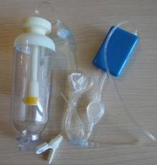
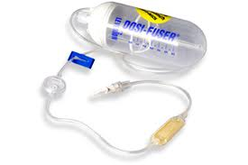
Acute Pain Delivery devices
Syringe pump
Infusor
Fornia
Dosi- fuser
Easy Pump
Electronic Pumps
Elastomeric Pumps
Time

Slide 33
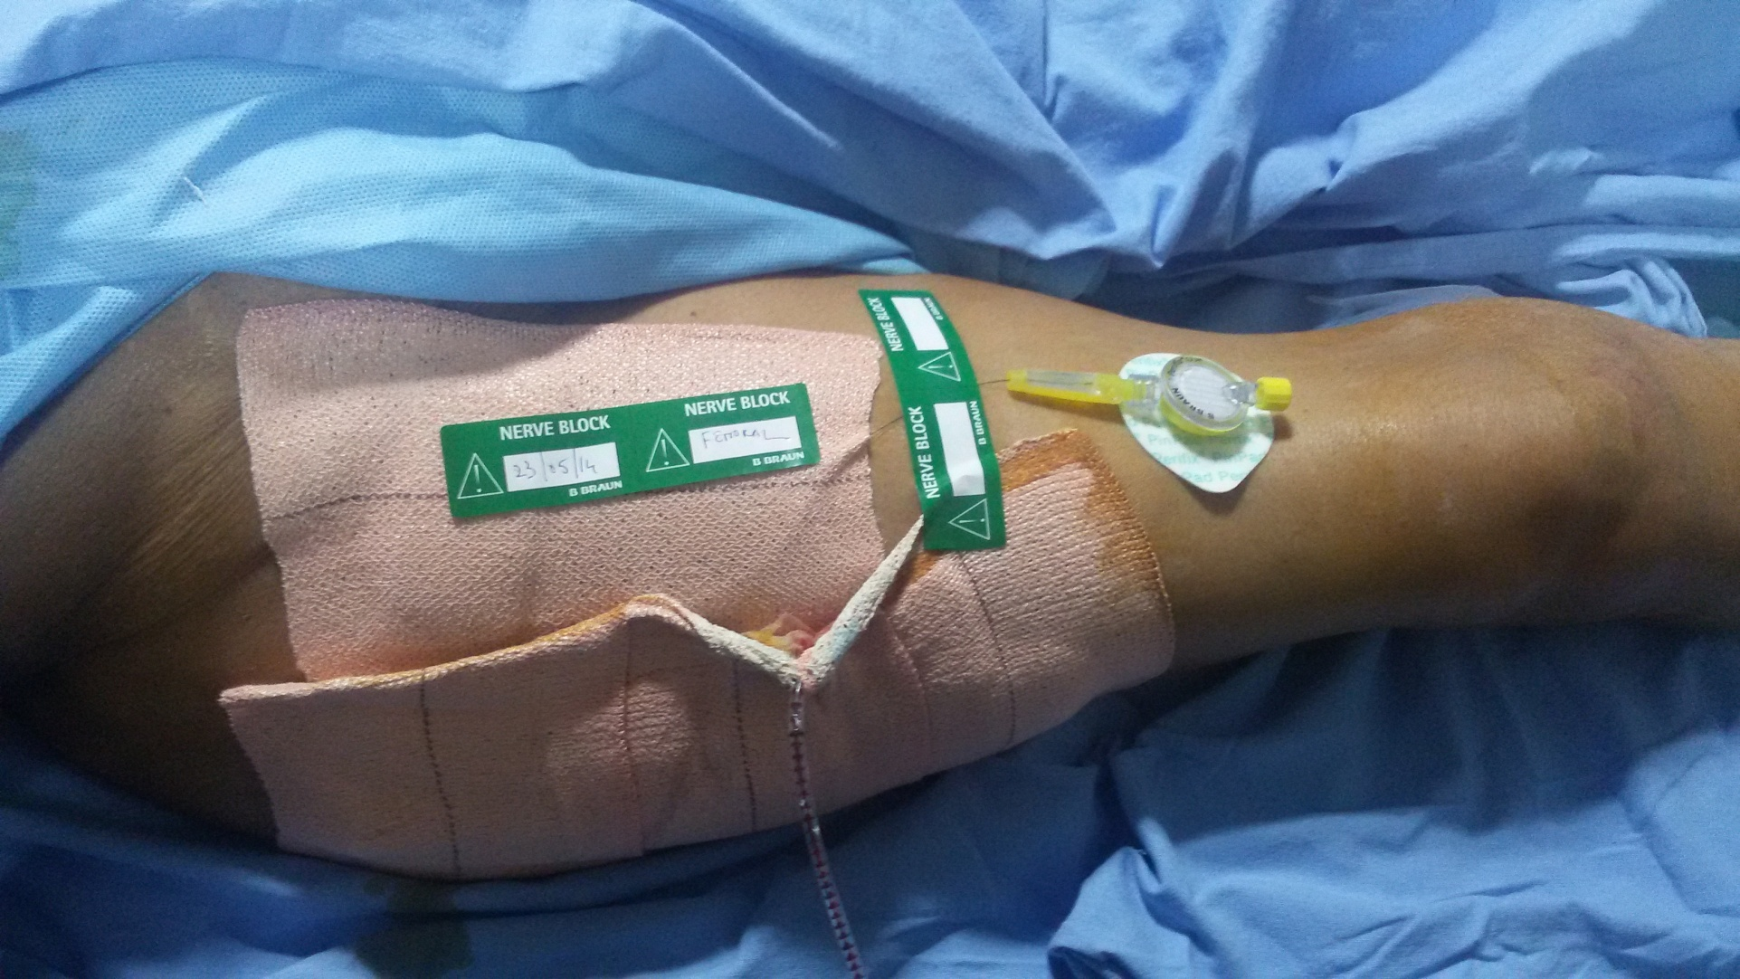
SITE SPECIFIC PAIN RELIEF

Slide 34
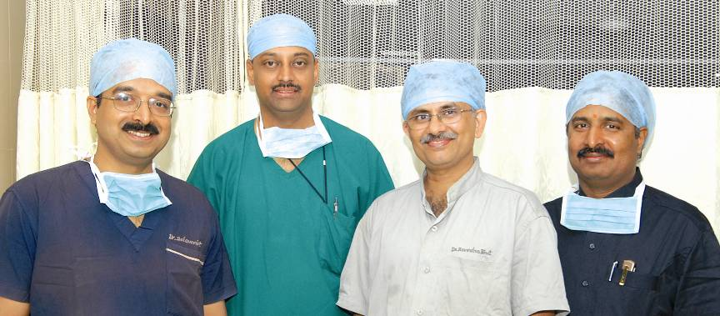
“ anaesthesiologist as perioperative physician”

Slide 35
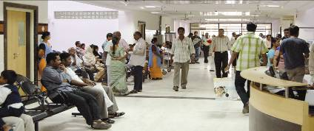
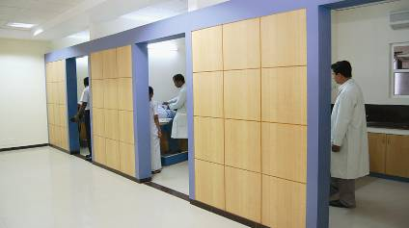
OUTPATIENT DEPARTMENT
SERVICES PROVIDED
ORTHOPAEDIC SPINE OPD ARTHROSCOPY FACIOMAXILLARY NEUROSURGERY DENTAL SPORTS MEDICINE BURNS PHYSIOTHERAPY REHABILITATION THERAPY
Notes:
All these ofcourse starts from the OUTPATIENT DEPARTMENT.The outpatient services provided range from “GENERAL ORTHOPAEDIC,ORTHOPAEDIC TRAUMA,SPINE OPD,ARTHROSCOPY,JOINT REPLACEMENT ,FACIOMAXILLARY,DENTAL ,SPORTS MEDICINE,PLASTIC SURGERY,BURNS ,PHYSIOTHERAPY,REHABILITATION THERAPY all under one roof.All the patients are comprehensively assessed by the anaesthesia department the minute they are scheduled for surgery ,all investigations sent be it biochemical,pathology,radiology and a strategy is drawn for the surgical procedure.Also the concept of “ BIOFEEDBACK” exists with the patients of joint replacement wherein they are shown the videos of previously performed joint replacement surgeries and all their queries answered.Also I would like to highlight the credible work done by PHYSICIAN ASSISTANTS who play a vital role & act as a link between patients and doctors

Slide 36
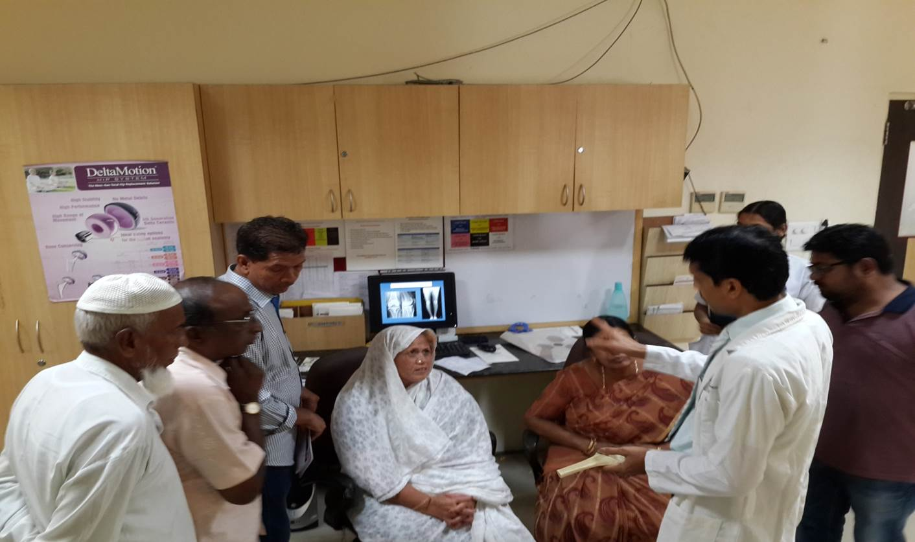
BIOFEEDBACK

Slide 37
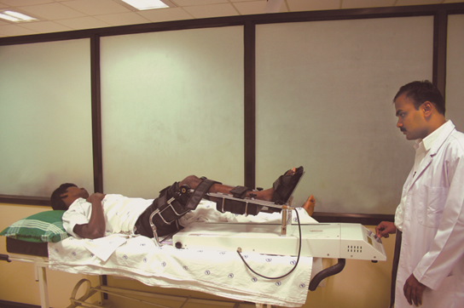
3 D:Physiotherapy and nursing
Notes:
A Sequential Compressive Device(SCD) was purchased to control Odema and has been Beneficial in treating patients with Lymphodema and post Operative Odema of Upper and Lower Limb.
.

Slide 38
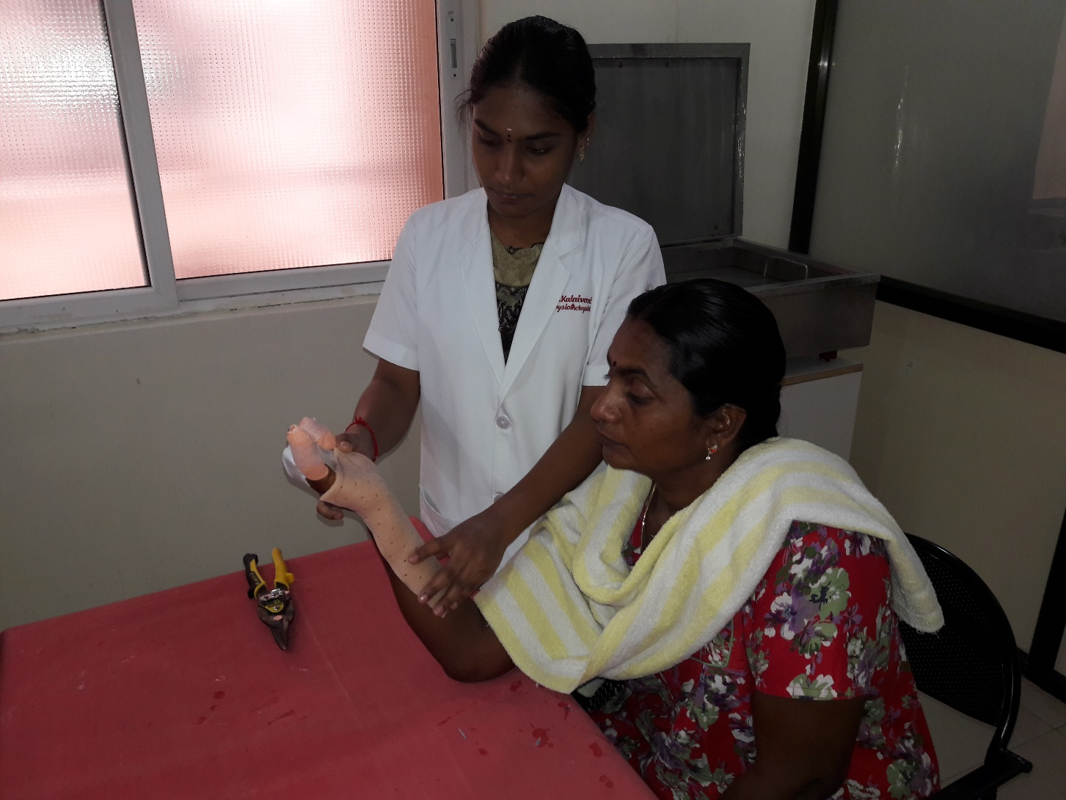
Notes:
Plastic Physiotherapy is equipped with Making Malleable Splint with Thermoplastic which plays a major role in Post Operative Care of major Crush and Cut Injuries.

Slide 39
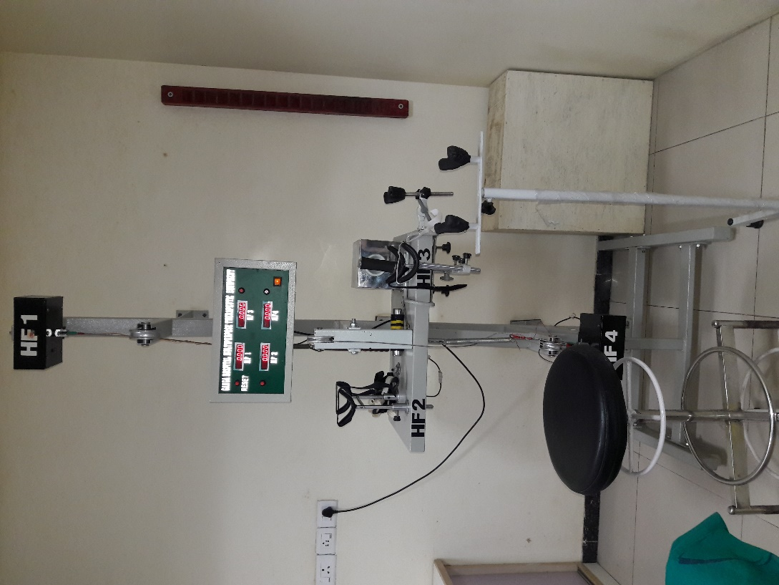
Strength of the upper extremity
Notes:
To measure the Strength for Upper Extremity a Equipment was designed and made with the help of the Bio-Medical Deparment in the hospital

Slide 40
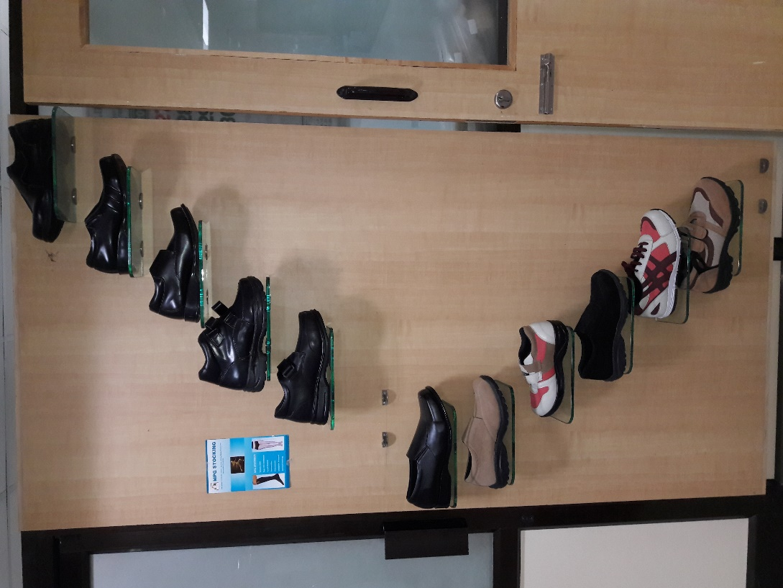

Slide 41
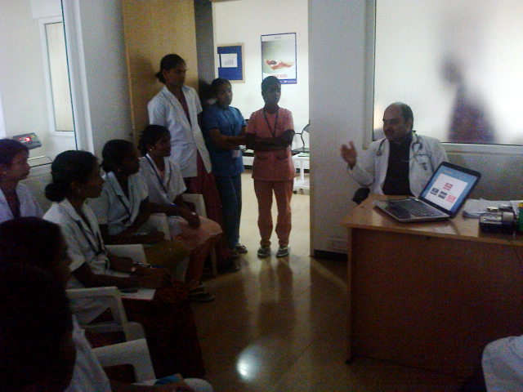
Nursing

Slide 42
Trauma nursing
Audits for self improvement
Pressure ulcer preventive audit
Root cause analysis audit
presurgery fasting audit
Notes:
Apart from dispensing their daily duties ,nursing department has carried out various audits for their self quality improvement, which need to be acknowledged . The pressure ulcer
preventive audit,root cause analysis reports dealing with various issues ,presurgery fasting audit are to name a few.
Nurses were taught to clean the wound with NS and use the medications recommended by the Doctors.
Back care techniques were demonstrated.
Nurses were insisted to document the progress of bedsore in the nurses’ chart.
Basic hygiene care audit was started to ensure that all the patients are receiving basic hygiene care by the nurses.
Patients have bedsores are supervised by the ward In charge nurses everyday reports will be updated to NS and DNS.
Bedsore free ward nurses were appreciated for their patient friendly nursing care.
90% of patient discharge from the hospital with healed bedsore irrespective of place of development.

Slide 43
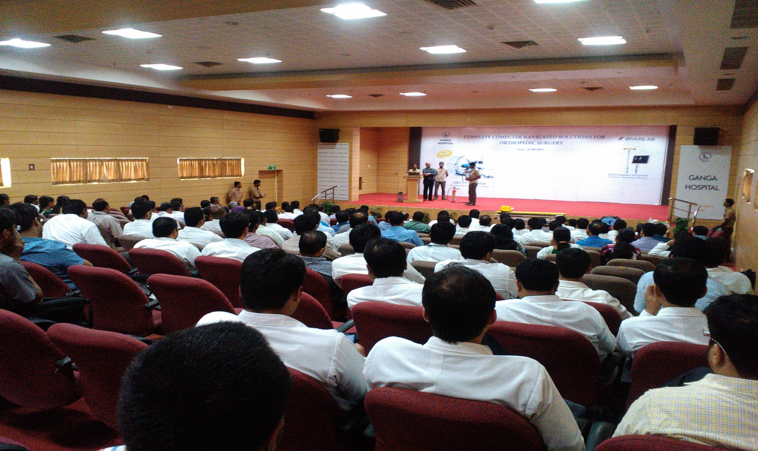
Special training for handling equipments
Special training for handling equipments
Notes:
Also the nursing department undergoes special training for instrument and equipment handling from the company personnel and consultants of the hospital.

Slide 44
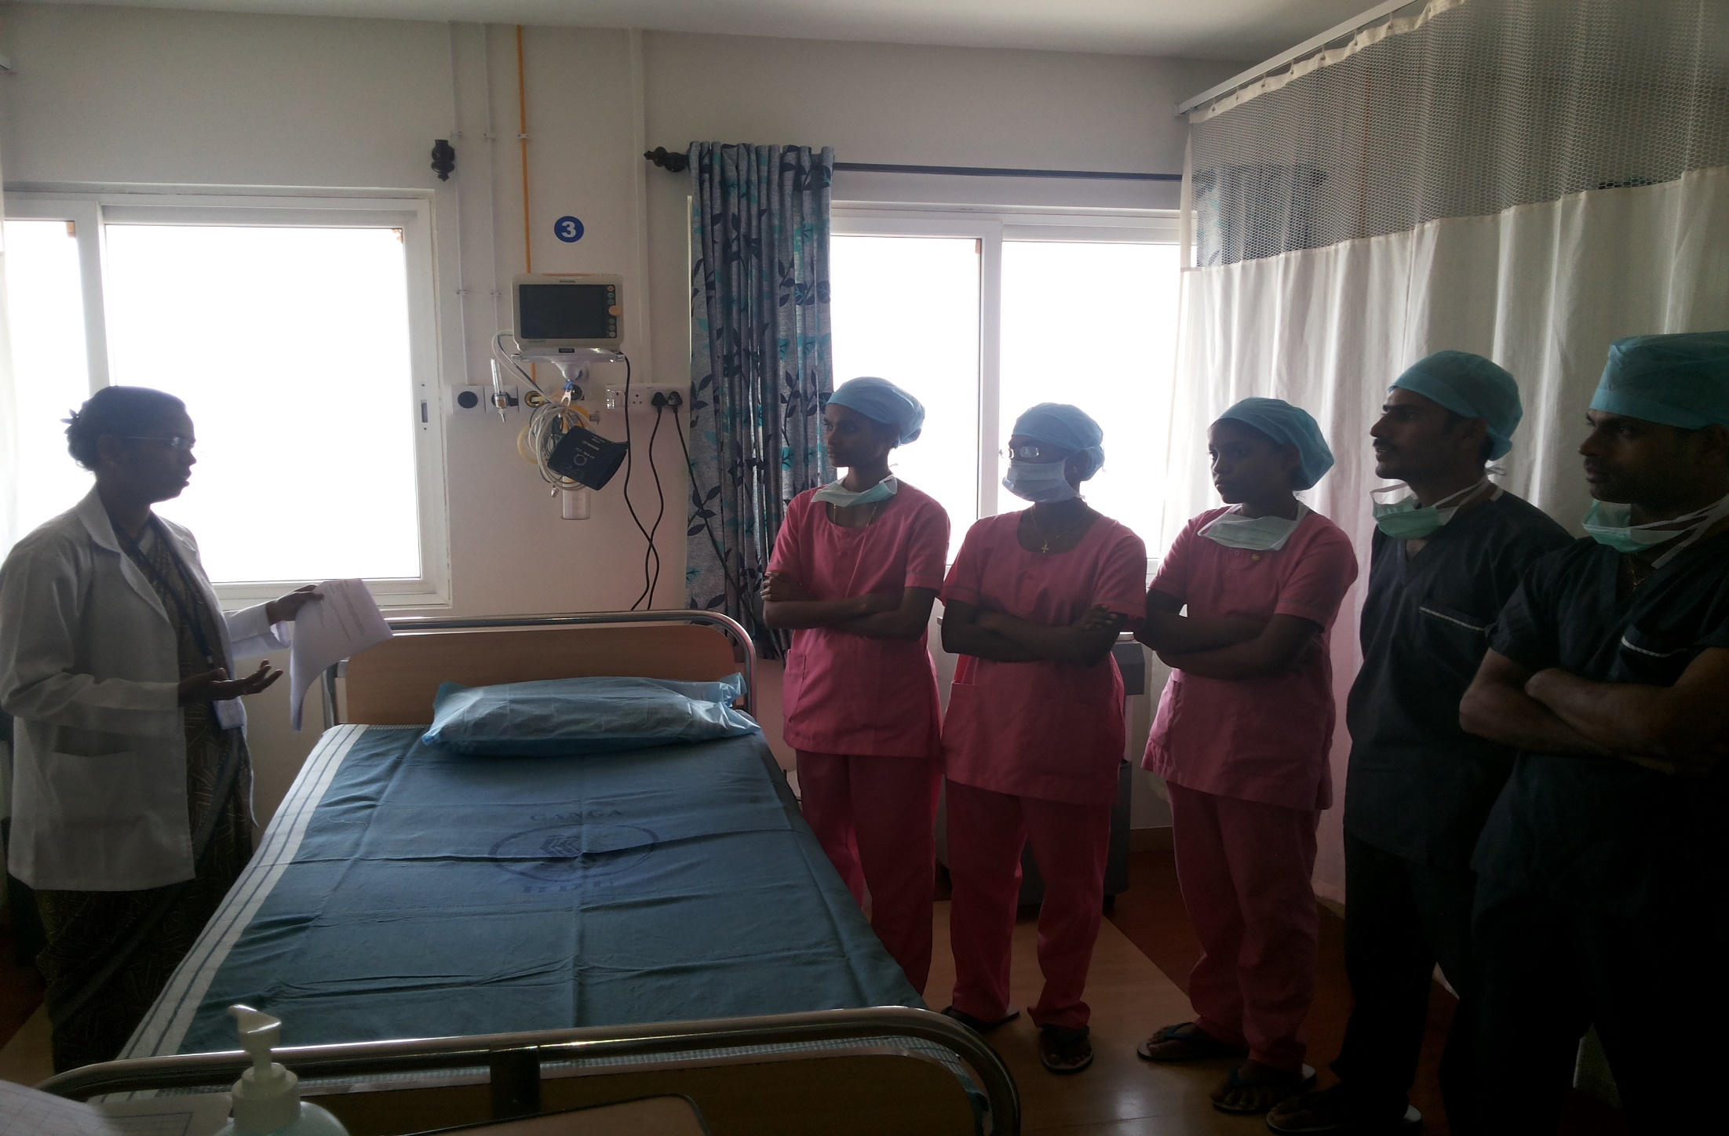
“One nurse per ward” EXCLUSIVE DIABETIC CARE
Notes:
A dedicated “One nurse per ward for EXCLUSIVE DIABETIC CARE “ concept has been implemented with the aim of minimising rescheduling or cancellation of surgeries due to high blood sugar levels,also it helps postoperatively to decrease the length of stay.

Slide 45
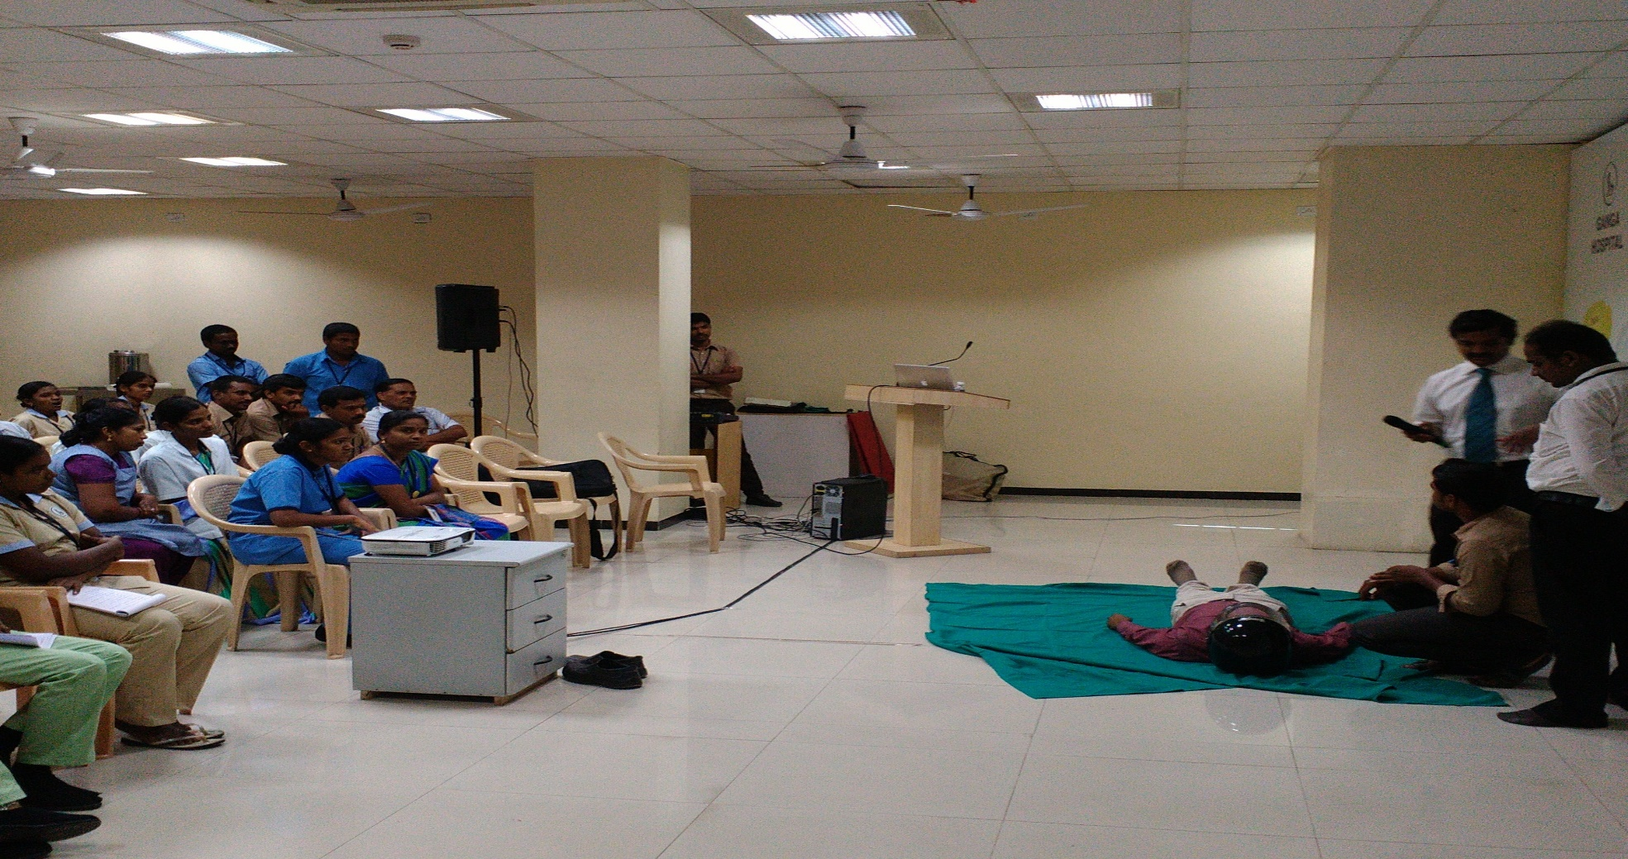
EMERGENCY AND TRAUMA
Notes:
“Emergency and trauma care” special training for physician assistants present round the clock in casualty and HDU

Slide 46

4 D :DIETARY
NUTRITIONAL SCREENING

Slide 47

appropriate plan of nutritional care according to health issues,surgery and individual requirements

Slide 48

Nutritional assesment

Slide 49

5 D : ADMINISTRATION

Slide 50
QUALITY CELL
CORE COMMITTEE
INFECTION CONTROL COMMITTEE
RESUSCITATION COMMITTEE
ETHICAL COMMITTEE
QUALITY ASSURANCE
FIRE AND SAFETY COMMITTEE
MEDICAL AUDIT COMMITTEE
PHARMACOTHERAPEUTIC COMMITTEE

Slide 51
Patient first
surgery
anaesthesia
Physiotherapy &nursing
Dietary
administration
Notes:
Here is an institution which works together in continuity ,offering the best of services 24 *7.by setting up policies which aid in emergency treatment of patient,high quality of surgical expertise including the infrastructure,the best perioperative care,active rehab,excellent nursing and an administration which makes all this smoothly possible.an integrated approach of all the five dimensions makes it all possible to achieve a better outcome in patient care that is patient first.

